Slide 1

Team Introduction
Sweta Shekhar Anima Sahu Priyal Jain
: 46282009
: 46282008
: 46282015
Approved By
Debashree Misra
Sristy Kedia : 46282005
Priti Priyadarshani Rout : 46282006

Slide 2




Automated Test Input Generator Software

Slide 3





CONTENT LIST
Abstract
Project Requirement Overview Individual Roles
Plan Overview Plan Procedures
Design Software & Programming Data Flow
Demonstration Functional Requirements Conclusion
References

Slide 4




ABSTRACT
The purpose of the project is to validate the input file and to create the desired number of output file for test cases. It is done to generate as many number of test case files as per requirement to be used in vast area of applications and to avoid any input error.

Slide 5
Project Requirement Overview
AIM :
The project is to implement an Automated Test Input Generation Software (ATIGS), aimed at automatically generating test data for an application.
REQUIREMENTS :
To read number of output files and input file path from command line. To read and store variable name,type and value..
To validate data in input file and identify comments , if present.
To produce the given number of output files with name value pairs.
To create a config file containing all the output files.

Slide 6


Individual Roles
Reading input file and CLI : Priti Priyadarshini Rout Input file validation : Anima Sahu
Creating and locating output file : Priyal Jain Integration of code : Sweta Shekhar
Storing content and displaying output file : Sristy Kedia

Slide 7





Plan Overview
To ease the development of the project assigned to us, we divided our project into four phases :
Phase 1 : System Analysis
Phase 2 : Plan
Phase 3: System Design
Phase 4 : System Implementation

Slide 8







Plan Procedures
Detailed planning of project on google meet Daily stand-ups to report updates
Meetings with mentor to get query resolved Small meets to discuss changes or improvements

Slide 9





Design Software & Programming
Design Software
Virtual Box Linux
Vi Editor
Design Programming
C language File Handling Shell Script

Slide 10
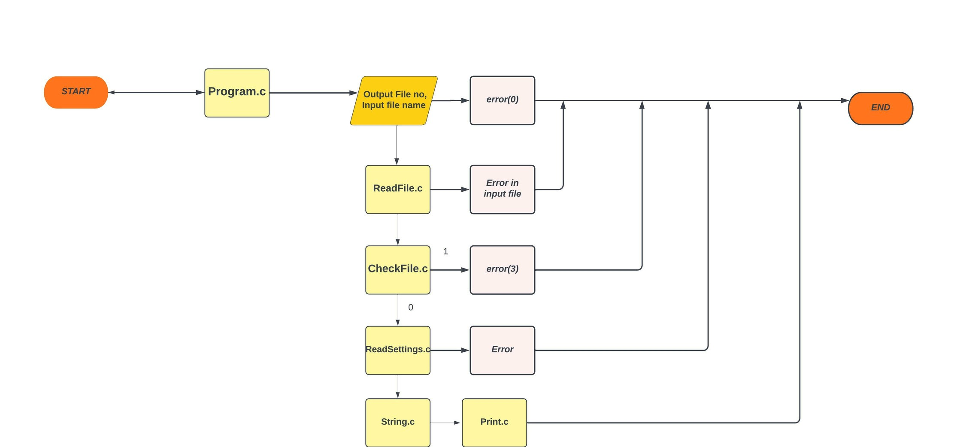
Data Flow
fig 1: Data Flow Diagram of ATIGS

Slide 11
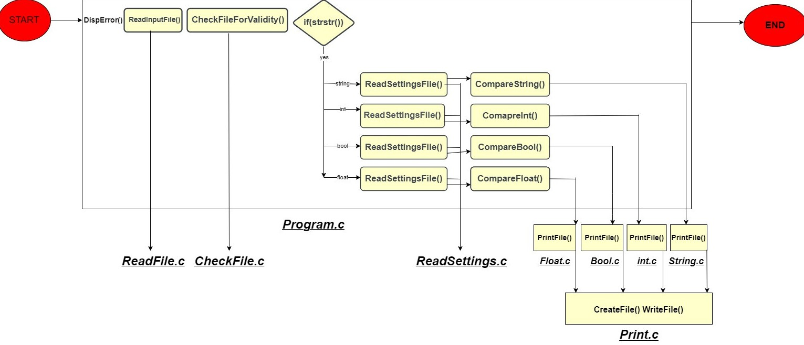
Data Flow
Detailed Data Flow of Code

Slide 12
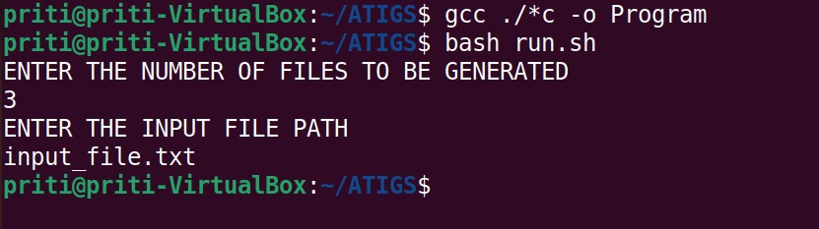
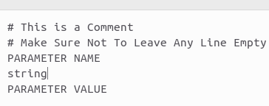
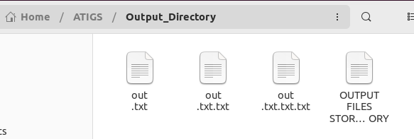
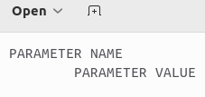
Demonstration
Input File with comments
Compilation and Execution of Program
Input File
Output Directory
Output File

Slide 13
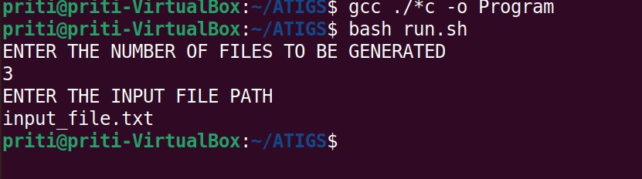

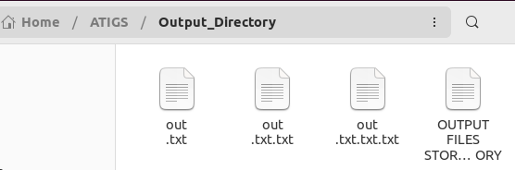
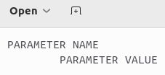
Demonstration
Input File Without Comment
Compilation and Execution of Program
Input File
Output Directory
Output File

Slide 14


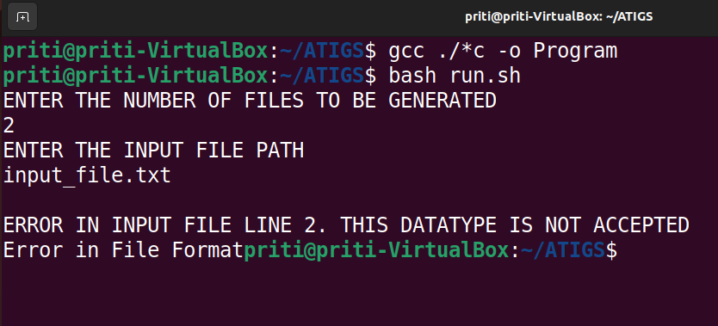
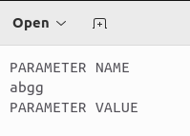


Demonstration
Input File with some error in it
Compilation and Execution of Program
Input File

Slide 15


Functional Requirements
Hardware Requirements :
RAM - 4GB or above
Processor - i3 / i5 / i7
Software Requirements :
Linux Operating System
GCC
Vi Editor
Bash

Slide 16
Conclusion
For developing Automated Test Case Generator Software , we have mainly used C language and File handling to accept input as well as deliever output. The main purpose was to check the input file and create desired number of outputs , which done manually could take a lot of time of the user. Also we have utilised shell scripting and command line inputs features for programming this code. This particular software limits to produce test cases for pre defined data types and could create error for other data types.

Slide 17
References
https://www.tutorialspoint.com/c_standard_library/c_function_atoi.htm https://www.tutorialspoint.com/cprogramming/c_command_line_argument s.htm
https://devenum.com/how-to-read-text-file-word-by-word-in-c/ https://www.geeksforgeeks.org/basics-file-handling-c/

Slide 18
Thank You

